Slide 1
Stored Procedures
Asst.Prof.Dr.Derya BİRANT
329 - Windows Programming

Slide 2
Contents
1
What is a Stored Procedure?
2
Stored Procedure Benefits
3
Stored Procedure Examples

Slide 3
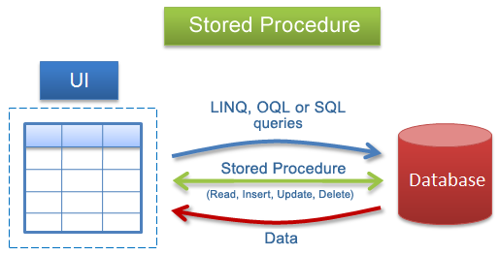
What is a Stored Procedure?
Stored Procedure is a batch of one or more SQL statements that are stored in the database.
Stored Procedures are similar to functions in that they are well-encapsulated blocks of logic that can accept data and return data.

Slide 4
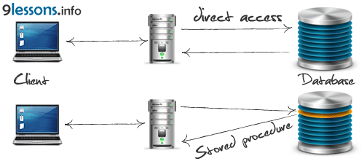
Stored Procedure Benefits
They are easier to maintain
They allow you to implement more secure database usage
They can improve performance

Slide 5
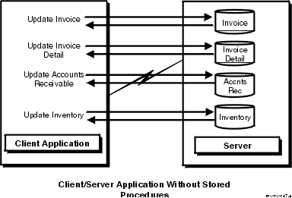
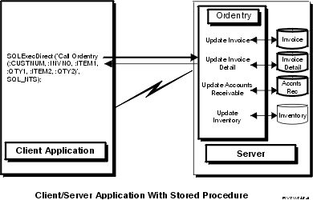
with – without Stored Procedure
this requires a minimum of eight messages between the server and the client
the communications traffic has been reduced to a single message pair.
the procedure can arrange to send back only the data that is absolutely required

Slide 6
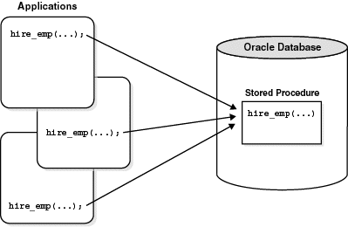
Stored Procedure Example

Slide 7
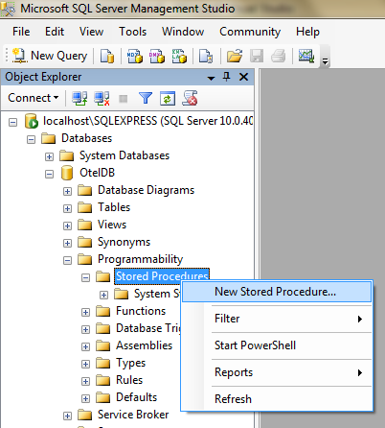
Creating New Stored Procedure

Slide 8
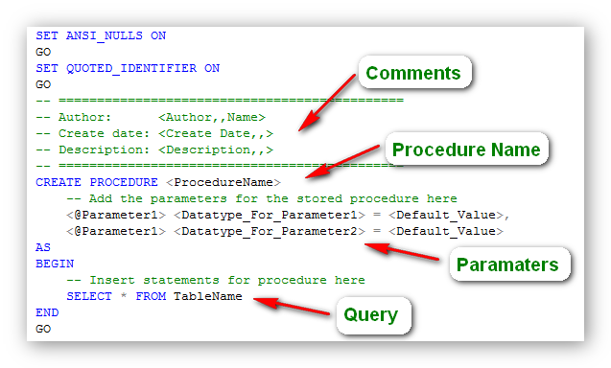
Creating a Stored Procedure

Slide 9


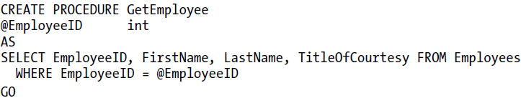
Example Stored Procedure (1)

Slide 10
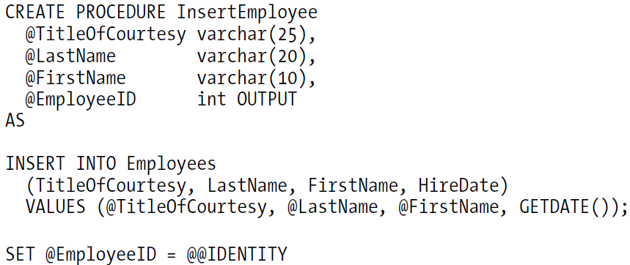
Example Stored Procedure (2)
A stored procedure for inserting a single record into the Employees table.
It returns the ID of the new record.

Slide 11
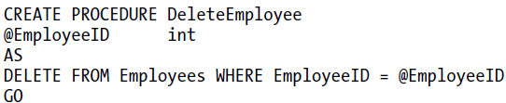
Example Stored Procedure (3)

Slide 12
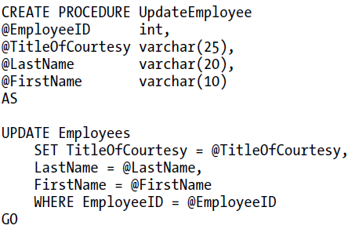
Example Stored Procedure (4)

Slide 13
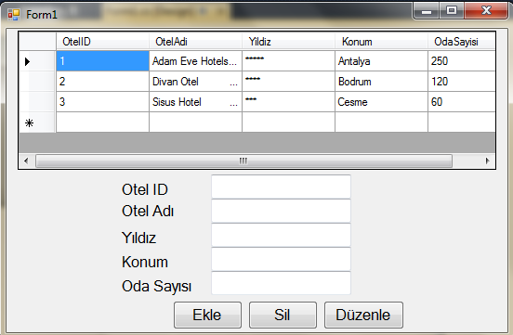
Let’s Do It !
Create four Stored Procedures (SelectOtel, InsertOtel, DeleteOtel, UpdateOtel)

Slide 14

CREATE PROCEDURE SelectOtel
AS
SELECT * FROM Oteller
private void Form1_Load(object sender, EventArgs e)
{
string connectionStr = "Data Source=localhost\\SQLEXPRESS;Initial
Catalog=OtelDB;Integrated Security=True";
SqlConnection con = new SqlConnection(connectionStr);
con.Open();
SqlCommand cmd = new SqlCommand("SelectOtel", con);
cmd.CommandType = CommandType.StoredProcedure;
SqlDataAdapter adap = new SqlDataAdapter(cmd);
DataTable dt = new DataTable();
adap.Fill(dt);
dataGridView1.DataSource = dt;
con.Close();
}

Slide 15
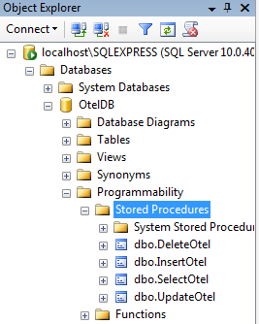
CREATE PROCEDURE InsertOtel
@OtelID int,
@OtelAdi nchar(30),
@Yildiz nchar(10),
@Konum nchar(20),
@OdaSayisi int
AS
INSERT INTO Oteller
VALUES (@OtelID, @OtelAdi, @Yildiz, @Konum, @OdaSayisi)
CREATE PROCEDURE DeleteOtel
@OtelID int
AS
DELETE FROM Oteller
WHERE OtelID = @OtelID
CREATE PROCEDURE UpdateOtel
@OtelID int,
@OtelAdi nchar(30),
@Yildiz nchar(10),
@Konum nchar(20),
@OdaSayisi int
AS
UPDATE Oteller
SET OtelAdi = @OtelAdi, Yildiz=@Yildiz, Konum=@Konum, OdaSayisi=@OdaSayisi
WHERE OtelID = @OtelID

Slide 16
private void button1_Click(object sender, EventArgs e) //EKLEME
{
string connectionStr = "Data Source=localhost\\SQLEXPRESS;Initial
Catalog=OtelDB;Integrated Security=True";
SqlConnection con = new SqlConnection(connectionStr);
con.Open();
SqlCommand cmd = new SqlCommand("InsertOtel", con);
cmd.CommandType = CommandType.StoredProcedure;
cmd.Parameters.AddWithValue("@OtelID", textBox1.Text);
cmd.Parameters.AddWithValue("@OtelAdi", textBox2.Text);
cmd.Parameters.AddWithValue("@Yildiz", textBox3.Text);
cmd.Parameters.AddWithValue("@Konum", textBox4.Text);
cmd.Parameters.AddWithValue("@OdaSayisi", textBox5.Text);
cmd.ExecuteNonQuery();
cmd.CommandText = "SELECT * FROM Oteller";
cmd.CommandType = CommandType.Text;
SqlDataAdapter adap = new SqlDataAdapter(cmd);
DataTable dt = new DataTable();
adap.Fill(dt);
dataGridView1.DataSource = dt;
con.Close();
}

Slide 17
private void button2_Click(object sender, EventArgs e)
{
string connectionStr = "Data Source=localhost\\SQLEXPRESS;Initial
Catalog=OtelDB;Integrated Security=True";
SqlConnection con = new SqlConnection(connectionStr);
con.Open();
SqlCommand cmd = new SqlCommand("DeleteOtel", con);
cmd.CommandType = CommandType.StoredProcedure;
cmd.Parameters.AddWithValue("@OtelID", textBox1.Text);
cmd.ExecuteNonQuery();
cmd.CommandText = "SELECT * FROM Oteller";
cmd.CommandType = CommandType.Text;
SqlDataAdapter adap = new SqlDataAdapter(cmd);
DataTable dt = new DataTable();
adap.Fill(dt);
dataGridView1.DataSource = dt;
con.Close();
}

Slide 18
private void button3_Click(object sender, EventArgs e)
{
string connectionStr = "Data Source=localhost\\SQLEXPRESS;Initial
Catalog=OtelDB;Integrated Security=True";
SqlConnection con = new SqlConnection(connectionStr);
con.Open();
SqlCommand cmd = new SqlCommand("UpdateOtel", con);
cmd.CommandType = CommandType.StoredProcedure;
cmd.Parameters.AddWithValue("@OtelID", textBox1.Text);
cmd.Parameters.AddWithValue("@OtelAdi", textBox2.Text);
cmd.Parameters.AddWithValue("@Yildiz", textBox3.Text);
cmd.Parameters.AddWithValue("@Konum", textBox4.Text);
cmd.Parameters.AddWithValue("@OdaSayisi", textBox5.Text);
cmd.ExecuteNonQuery();
cmd.CommandText = "SELECT * FROM Oteller";
cmd.CommandType = CommandType.Text;
SqlDataAdapter adap = new SqlDataAdapter(cmd);
DataTable dt = new DataTable();
adap.Fill(dt);
dataGridView1.DataSource = dt;
con.Close();
}

Slide 19
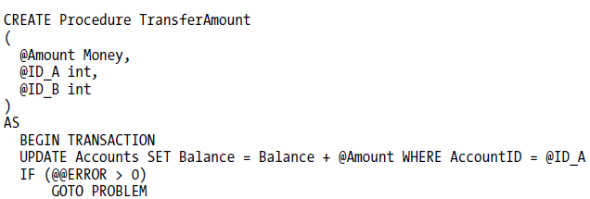


Transactions in Stored Procedures

Slide 20
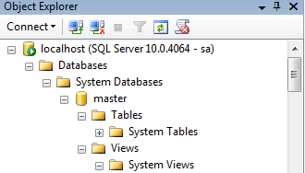
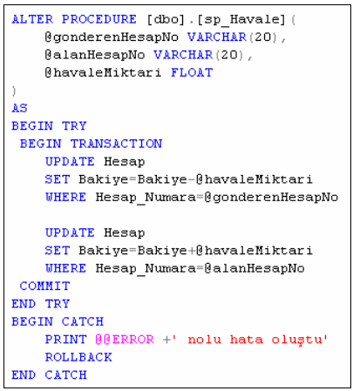

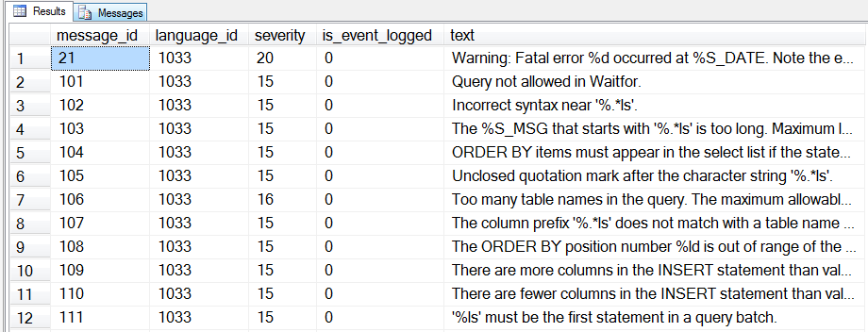

Slide 21
Transactions in Stored Procedures
CREATE PROCEDURE Musteri_Ekleme
(
@MusteriNo as char(10),
@MusteriAdi as char(20),
@MusteriSoyadi as char(20),
@Adres as char(30),
@Tel as char(12)
)
AS
declare @number int
BEGIN TRANSACTION
select @number=COUNT(*)
from musteri
where (musterino=@MusteriNo)
if @number>0 goto on_error
INSERT INTO Musteri
(MusteriNo, MusteriAdi, MusteriSoyadi, Adres, Tel)
VALUES (@MusteriNo, @MusteriAdi, @MusteriSoyadi, @Adres, @Tel)
IF (@@ERROR <> 0) GOTO on_error
COMMIT TRANSACTION
RETURN
on_error:
ROLLBACK TRANSACTION
RETURN
GO

Slide 22
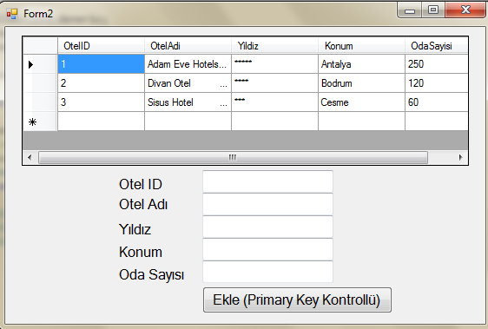
Let’s Do It !

Slide 23
CREATE PROCEDURE InsertOtelwithTransaction
@OtelID int,
@OtelAdi nchar(30),
@Yildiz nchar(10),
@Konum nchar(20),
@OdaSayisi int
AS
declare @number int
BEGIN TRANSACTION
select @number=COUNT(*)
from Oteller
where (OtelID=@OtelID)
if @number>0 goto on_error
INSERT INTO Oteller
VALUES (@OtelID, @OtelAdi, @Yildiz, @Konum, @OdaSayisi)
IF (@@ERROR <> 0) GOTO on_error
COMMIT TRANSACTION
RETURN
on_error:
ROLLBACK TRANSACTION
RETURN

Slide 24
private void button1_Click(object sender, EventArgs e)
{
string connectionStr = "Data Source=localhost\\SQLEXPRESS;Initial
Catalog=OtelDB;Integrated Security=True";
SqlConnection con = new SqlConnection(connectionStr);
con.Open();
SqlCommand cmd = new SqlCommand("InsertOtelwithTransaction", con);
cmd.CommandType = CommandType.StoredProcedure;
cmd.Parameters.AddWithValue("@OtelID", textBox1.Text);
cmd.Parameters.AddWithValue("@OtelAdi", textBox2.Text);
cmd.Parameters.AddWithValue("@Yildiz", textBox3.Text);
cmd.Parameters.AddWithValue("@Konum", textBox4.Text);
cmd.Parameters.AddWithValue("@OdaSayisi", textBox5.Text);
if (cmd.ExecuteNonQuery()==-1)
MessageBox.Show("Lütfen OtelID'yi değiştiriniz");
cmd.CommandText = "SELECT * FROM Oteller";
cmd.CommandType = CommandType.Text;
SqlDataAdapter adap = new SqlDataAdapter(cmd);
DataTable dt = new DataTable();
adap.Fill(dt);
dataGridView1.DataSource = dt;
con.Close();
}

Slide 25
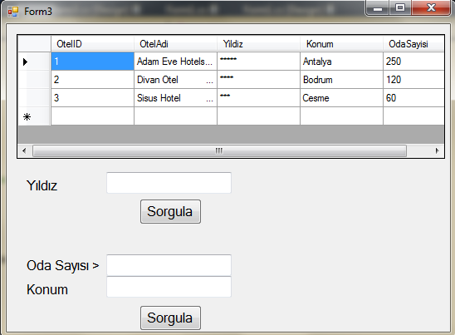
Let’s Do It !
Write two stored procedures for two different queries

Slide 26
CREATE PROCEDURE QueryYildiz
@Yildiz nchar(10)
AS
SELECT * FROM Oteller
WHERE Yildiz = @Yildiz
private void button1_Click(object sender, EventArgs e)
{
string connectionStr = "Data Source=localhost\\SQLEXPRESS;Initial
Catalog=OtelDB;Integrated Security=True";
SqlConnection con = new SqlConnection(connectionStr);
con.Open();
SqlCommand cmd = new SqlCommand("QueryYildiz", con);
cmd.CommandType = CommandType.StoredProcedure;
cmd.Parameters.AddWithValue("@Yildiz", textBox1.Text);
SqlDataAdapter adap = new SqlDataAdapter(cmd);
DataTable dt = new DataTable();
adap.Fill(dt);
dataGridView1.DataSource = dt;
con.Close();
}

Slide 27
CREATE PROCEDURE QueryOdaSayisiKonum
@Konum nchar(20),
@OdaSayisi int
AS
SELECT * FROM Oteller
WHERE Konum = @Konum and
OdaSayisi > @OdaSayisi
private void button2_Click(object sender, EventArgs e)
{
string connectionStr = "Data Source=localhost\\SQLEXPRESS;Initial
Catalog=OtelDB;Integrated Security=True";
SqlConnection con = new SqlConnection(connectionStr);
con.Open();
SqlCommand cmd = new SqlCommand("QueryOdaSayisiKonum", con);
cmd.CommandType = CommandType.StoredProcedure;
cmd.Parameters.AddWithValue("@OdaSayisi", textBox2.Text);
cmd.Parameters.AddWithValue("@Konum", textBox3.Text);
SqlDataAdapter adap = new SqlDataAdapter(cmd);
DataTable dt = new DataTable();
adap.Fill(dt);
dataGridView1.DataSource = dt;
con.Close();
}

Slide 28
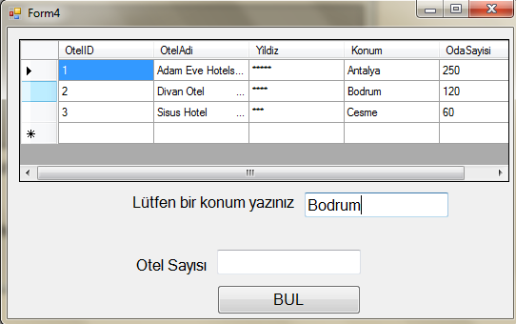
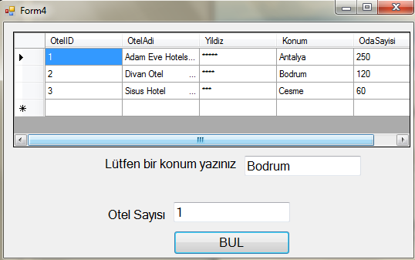
Use an Output Parameter
Verilen bir Konumda kaç tane otel bulunduğunu bulan sorguyu yazınız.

Slide 29
CREATE PROCEDURE QueryOtelSayisi
@Konum nchar(50),
@Sayi int OUTPUT
AS
SELECT @Sayi = Count(OdaSayisi)
FROM Oteller
WHERE Konum = @Konum
private void button1_Click(object sender, EventArgs e)
{
string connectionStr = "Data Source=localhost\\SQLEXPRESS;Initial
Catalog=OtelDB;Integrated Security=True";
SqlConnection con = new SqlConnection(connectionStr);
con.Open();
SqlCommand cmd = new SqlCommand("QueryOtelSayisi", con);
cmd.CommandType = CommandType.StoredProcedure;
cmd.Parameters.AddWithValue("@Konum", textBox1.Text);
cmd.Parameters.AddWithValue("@Sayi", 0);
cmd.Parameters[1].Direction = ParameterDirection.Output;
cmd.ExecuteNonQuery();
textBox2.Text = cmd.Parameters[1].Value.ToString();
con.Close();
}

Slide 30
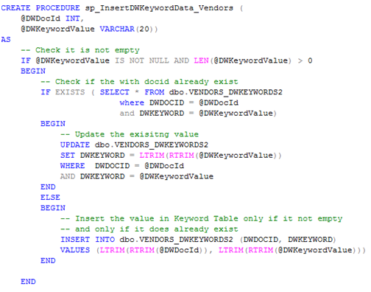
Example

Slide 31
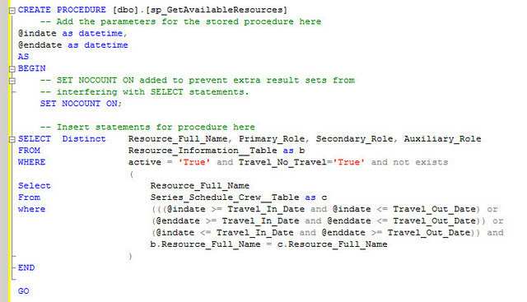
Example

Slide 32

See you next week!
Asst.Prof.Dr.Derya BİRANT
328 - Web Based Windows Programming

